Slide 1
Introduction to image processing and analysis with ImageJ / Fiji. Part 1 Digital Images
Dale Moulding
UCL Institute of Child Health Imaging Facility

Slide 2
What is a digital image ?

Slide 3

Bitmap/raster
Vector
Array of points (pixels)
Not scalable (aliasing)
Mathematical/geometric equations
Scalable
Microscopy Images
Photoshop/GIMP
ImageJ
Illustrator/Inkscape
Acrobat

Slide 4
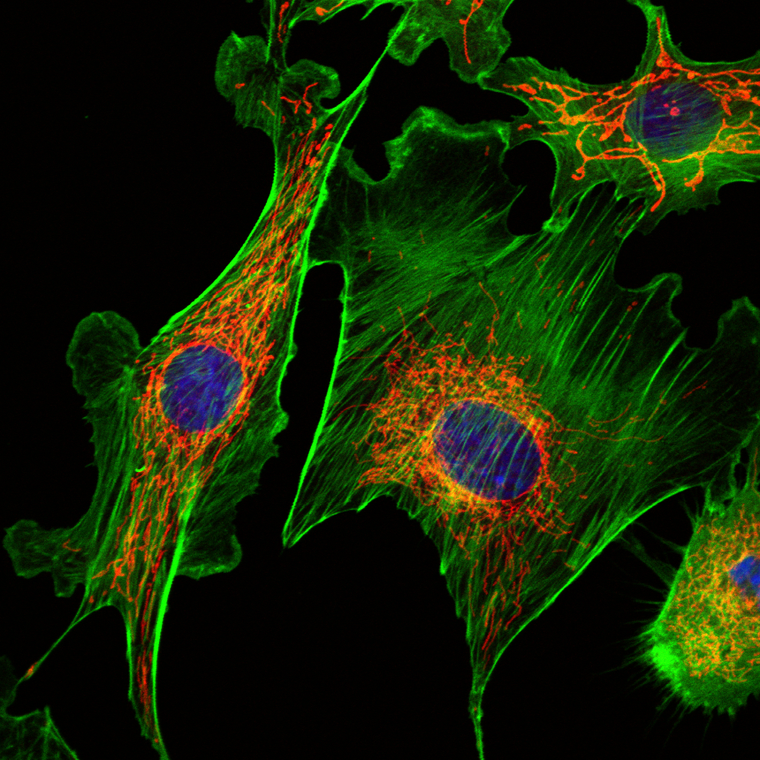
Microscope bitmap image

Slide 5
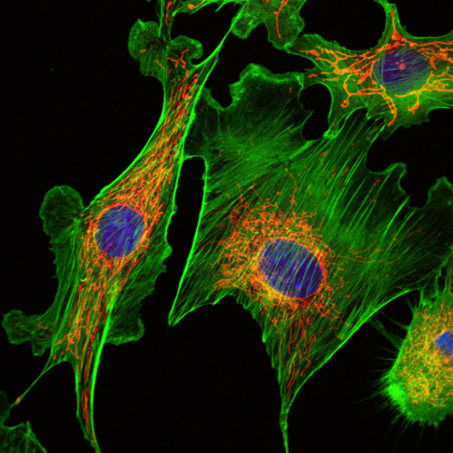
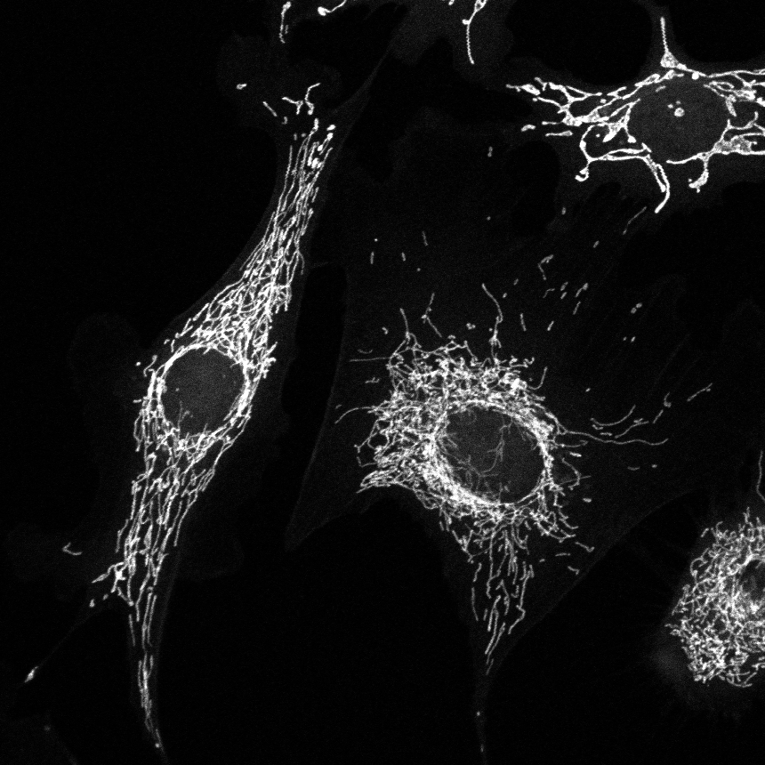
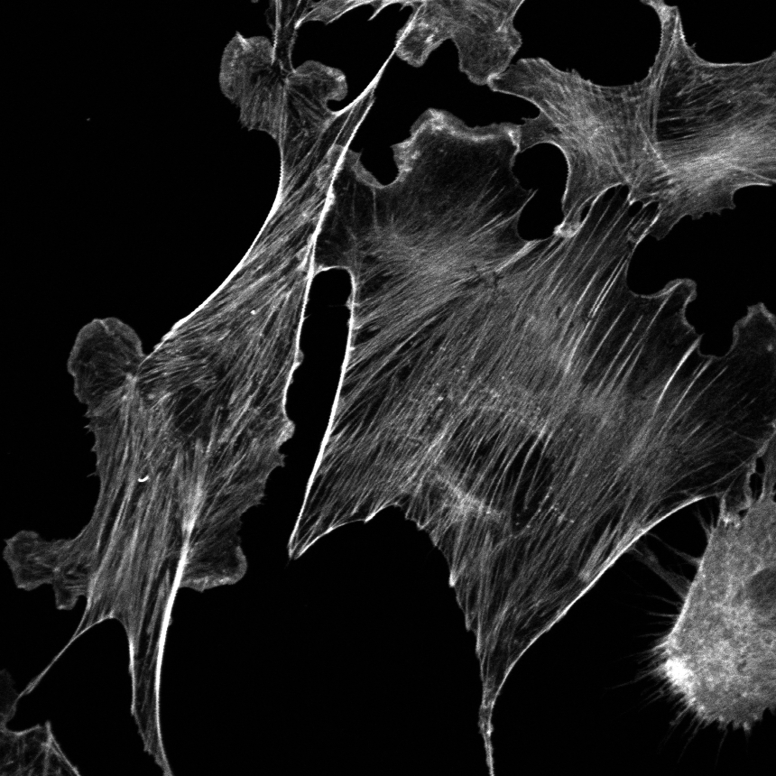
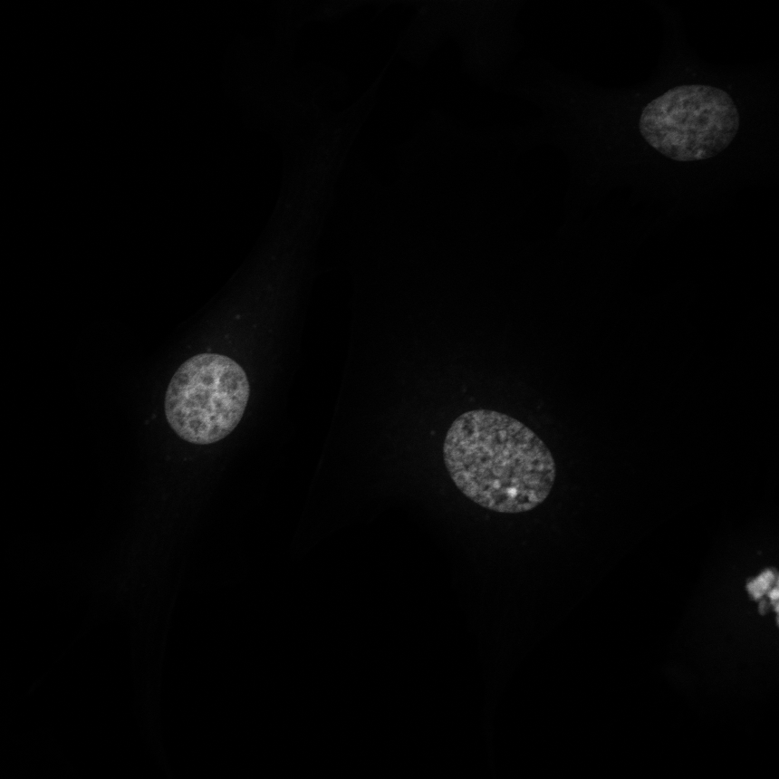
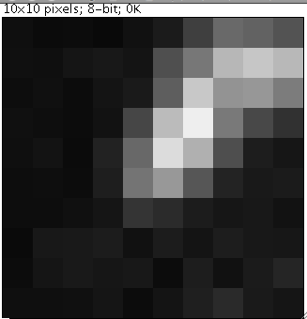
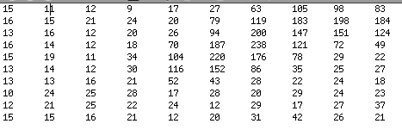
RGB
24-bits
Red
8-bits
Green
8-bits
Blue
8-bits
94
200
147
Y
187
238
121
220
176
78
X

Slide 6
Microscope bitmap image
A matrix of numbers
Each number represents light intensity at a particular coordinate in the plane
Pixel depth : the pixel intensity range
Color is provided by the look-up table
Additional data : what, where, when, how ? = metadata

Slide 7
Hands on example in ImageJ
Exercise 1) Images are numbers
File / Open Samples / Blobs
File / Save as > Text Image…
Drag the txt file to ImageJ window…
Now make the blobs window binary (black and white)
Process / Binary > make binary
Save as a text image…
Open the second text image.
Now import the text images (File / Import > Text Image…)
They are still pictures, but one is now back to front (inverted),
But check the Blobs sample image (inverted LUT).

Slide 8
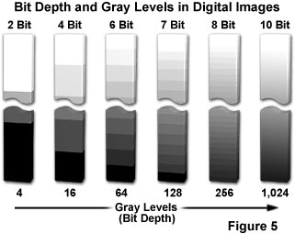
Bit depth
The sample signal intensity (infinite number of steps) is converted to pixel values (limited number of steps) by the sensor.
8-bit : from 0 to 255 (2⁸=256 steps)
12-bit : from 0 to 4095 (2¹²=4096 steps)
16-bit : from 0 to 65535 (2¹⁶=65536 steps)
32-bit : from 0 to 1 with 16 decimal precision = 16 millions steps
RGB : three 8-bit grayscale channels for red, green and blue
Computer monitors can’t display more than 256 levels for each colour (8 bits)
We can’t really distinguish between more than 256 grey levels (8 bits)

Slide 9
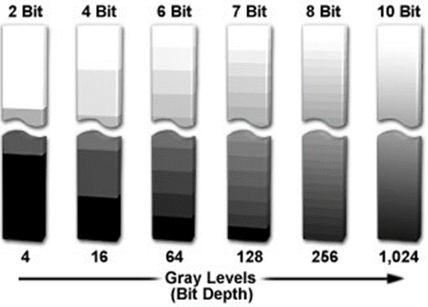
8 bit - 256 levels
4 bit - 16 levels
2 bit - 4 levels
1 bit - binary

Slide 10
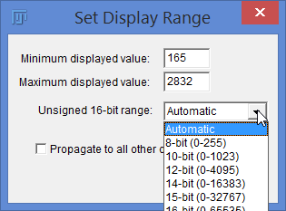
Guide for the Choice of Bit-Depth
12- 16-bits for scientific quality data, quantitation, post-acquisition deconvolution
8-bit for publication figures, website, routine acquisitions (shape identification, counting)
Often software won’t open files correctly with a bit depth above 8-bits.
Too bright, black or very dark frame when opening the files = wrong bit depth
Bit depth conversion is required
ImageJ can cope with all bit depths, but a file may open that is too bright…
Edit / adjust /
Brightness & Contrast…
Set…
Exercise 2) Bit depth display

Slide 11
Bit-depth conversion
Change the bit-depth of an image
Reduce the file size as an 8-bit image is half the size of 16-bit image
Some algorithms and ImageJ functions only run with 8-bit images
others need 32 bit float (for complex maths)

Slide 12
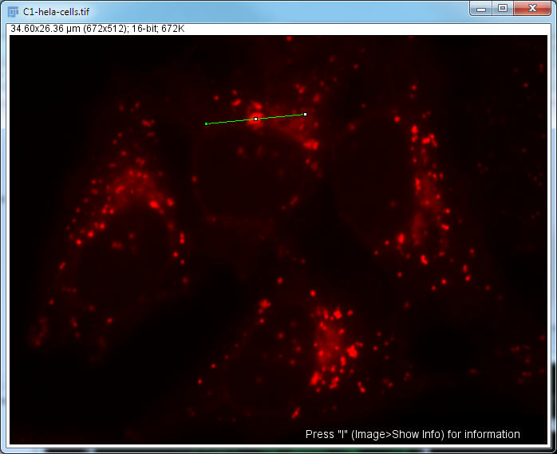
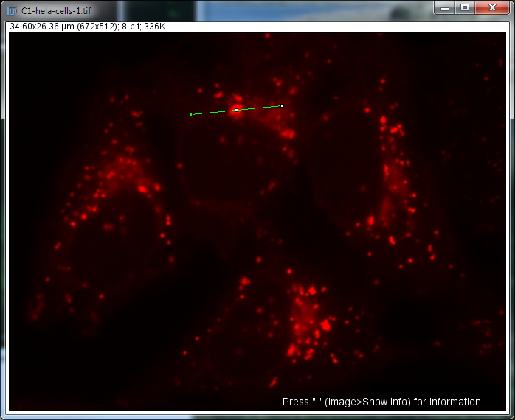
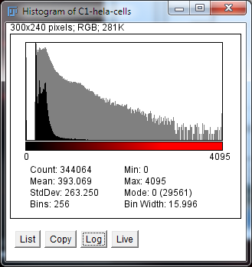
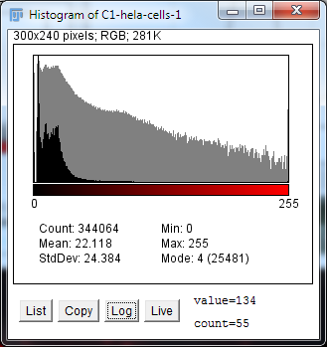
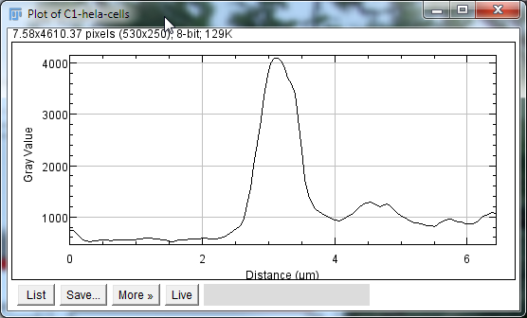
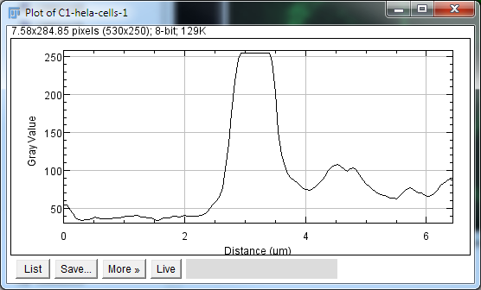
16 (or 12) bit v 8 bit
Exercise 3) Changing channels, LUTs & bit depth

Slide 13
Colour
Monochrome CCD cameras and confocal photomultipliers (PMT) do not “see” colour.
CCD sensor and PMT detect photons independently of their wavelengths (within their detection range).
The wavelengths detected depend on the filter set installed inside the microscope
Colour is then applied via software

Slide 14
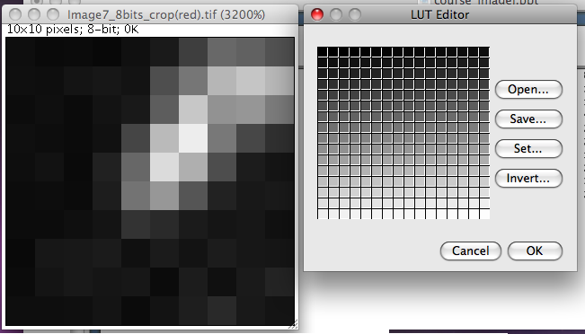
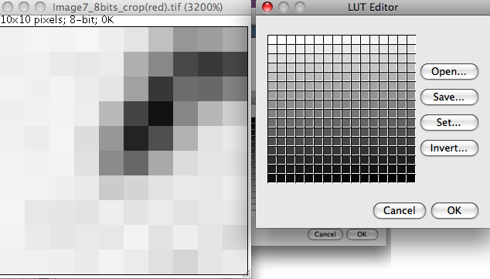
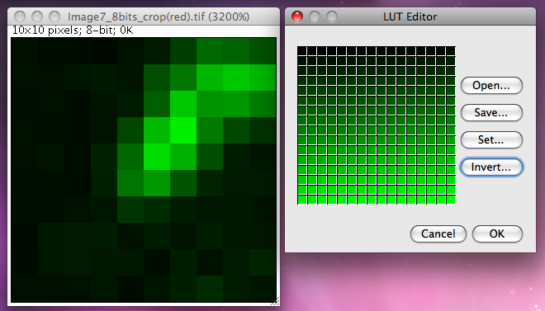
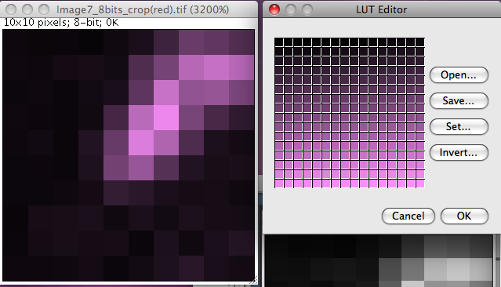
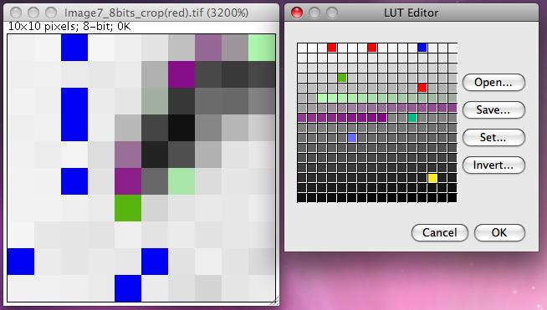
Look-up table (LUT)
0
255
Image /
Color >
LUT Editor

Slide 15
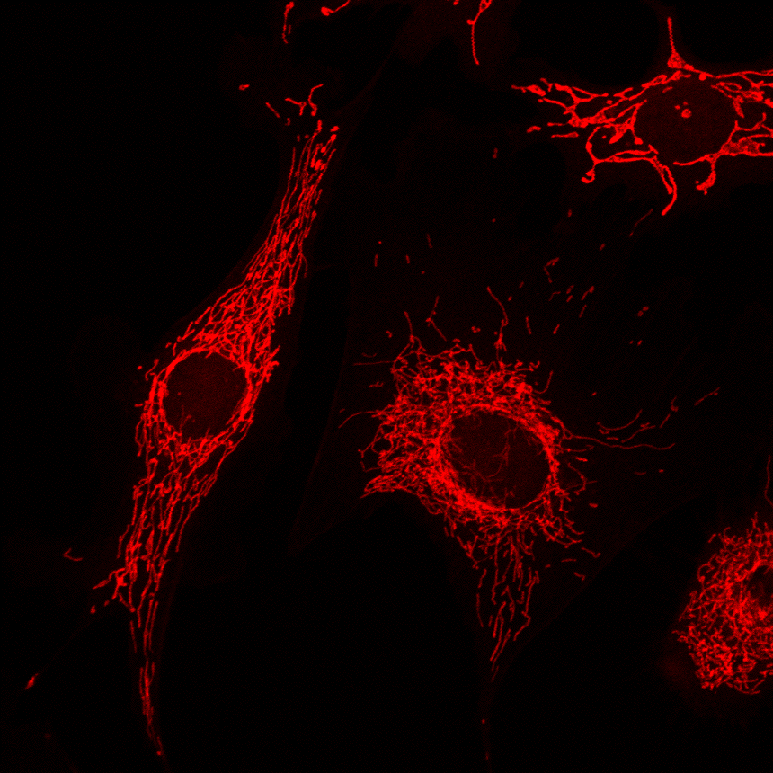
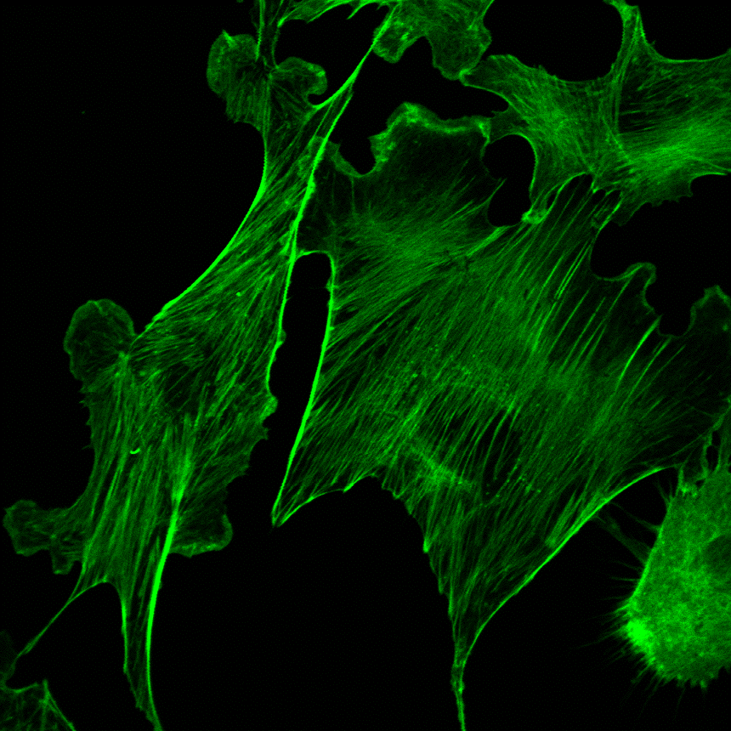
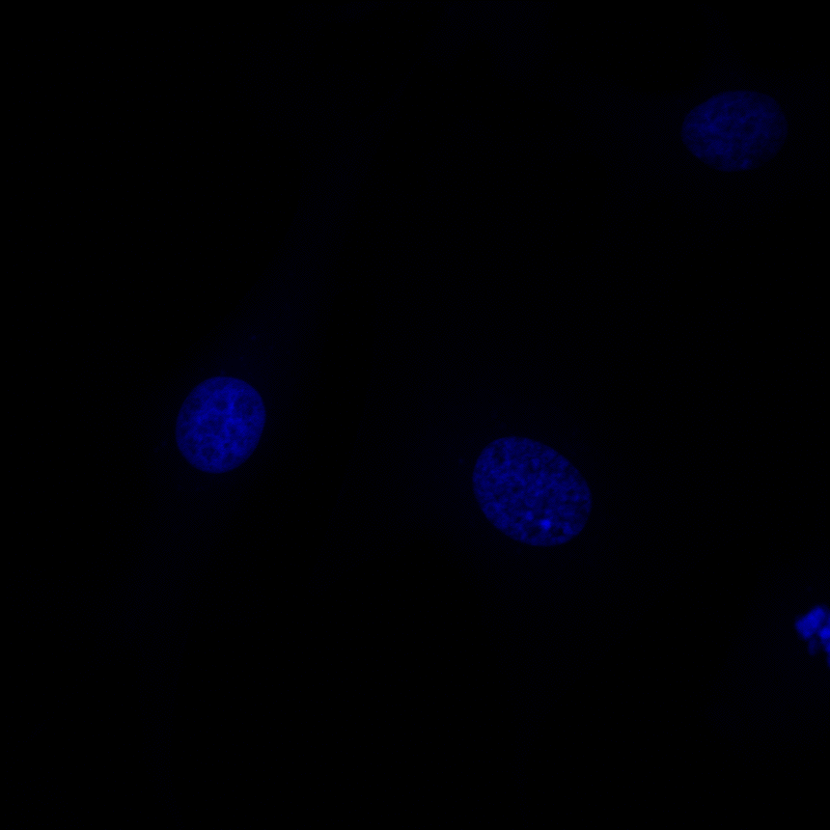
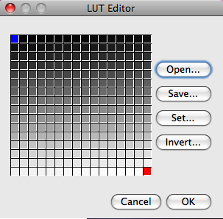
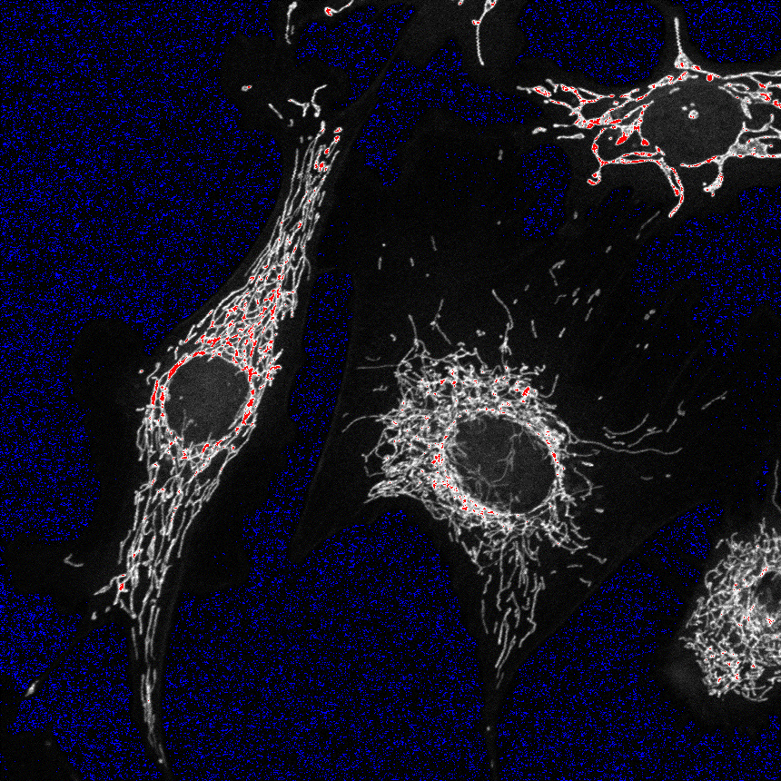
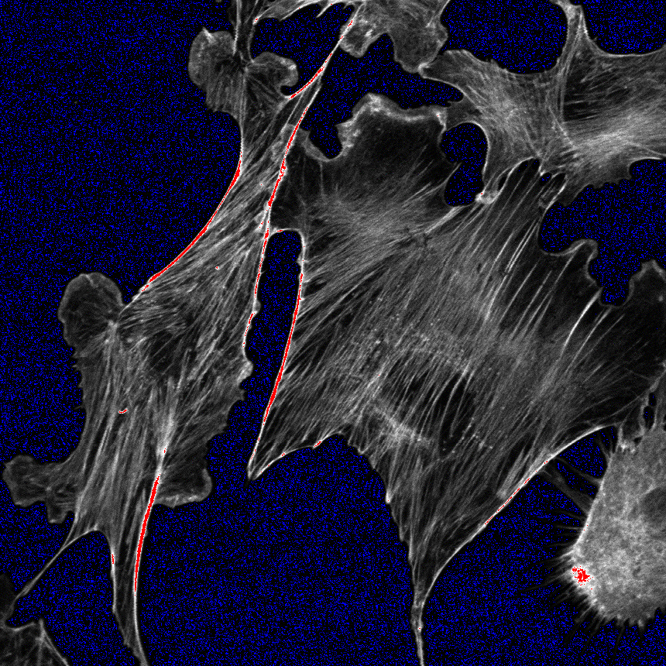
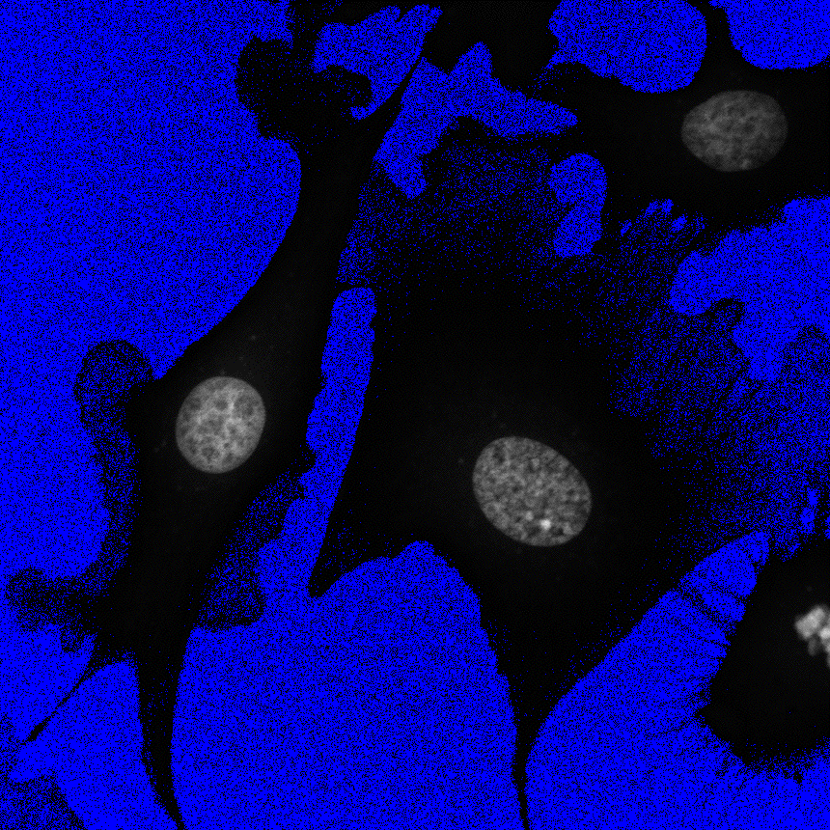
RGB
Red
Green
Blue
Color is provided by the look-up table, color is always false

Slide 16
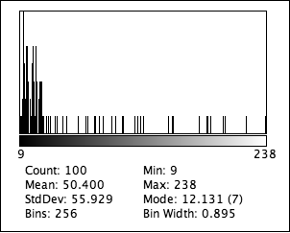
Histogram : pixel intensity distribution

Slide 17
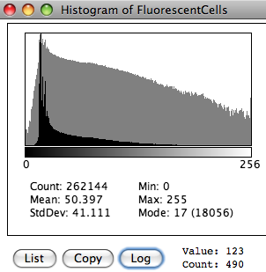
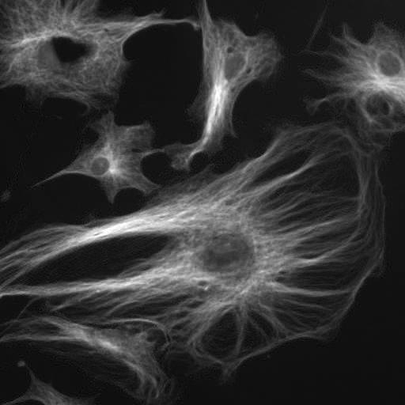
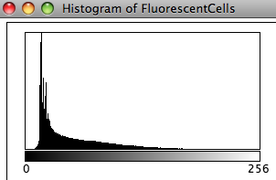
Histogram : pixels distribution
the distribution of pixels intensity (x axis) plotted against the number of pixel (Y axis) independently of their localisation within the picture
Use histogram to fill the dynamic range during image acquisition

Slide 18
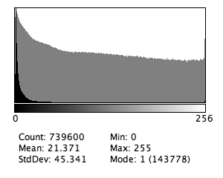
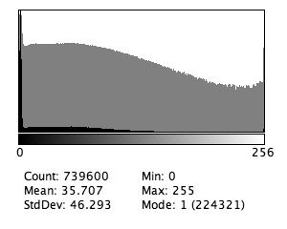
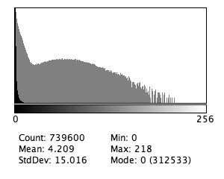
RGB
Red
Green
Blue
RGB color
8-bits per channel

Slide 19
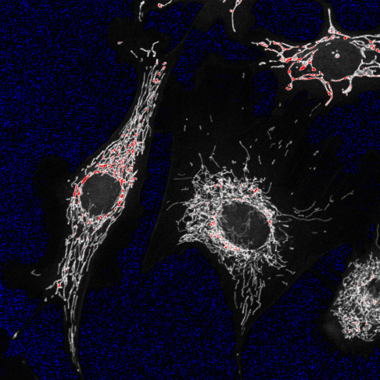
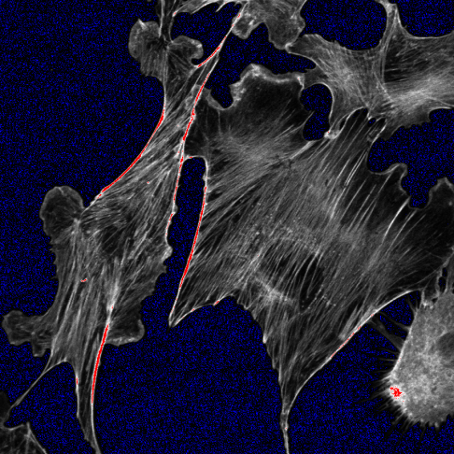
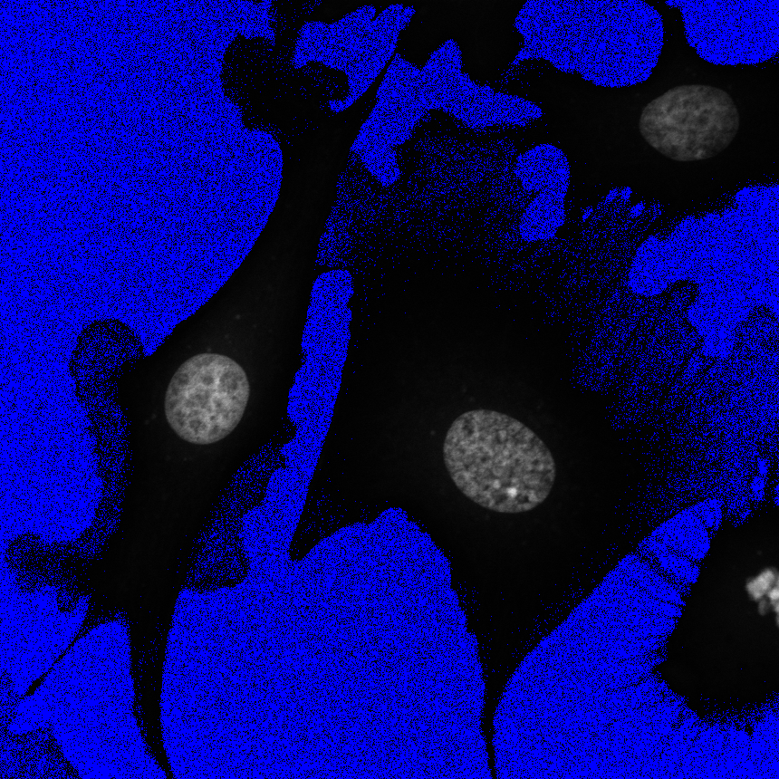
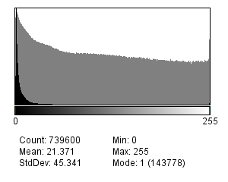
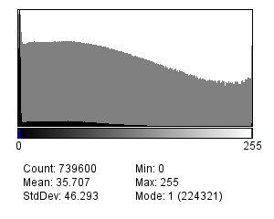
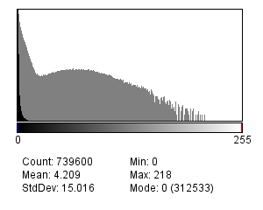
RGB
Red
Green
Blue
Exercise 4) Using Histograms and LUTs to check image acquisition

Slide 20
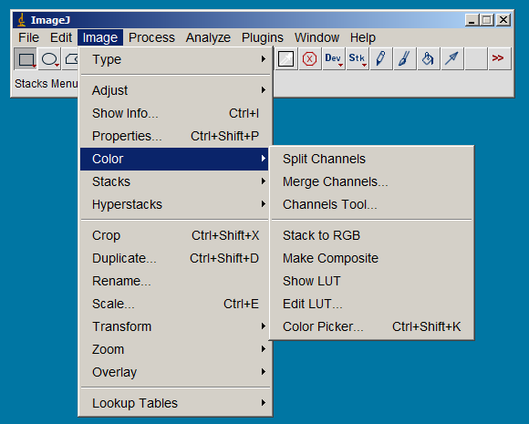
Image / Color
Open Sample Image… fluorescent cells.
Separates each colour
Puts them back together
View all together or one at time
Reverse of Stack to RGB

Slide 21
Composite Images
In a composite image colours are handled through channels. The advantages with this type of image over plain RGB images are:
Each channel is kept separate from the others and can be turned on and off using the ‘Channels’ tool (Image▷Color▷Channels Tool… ). This feature allows measurements on a specific channel while visualizing multiple.
Channels can be 8, 16 or 32-bit and can be displayed with any lookup table
More than 3 channels can be merged or kept separate (open sample image ‘Neuron’)

Slide 22
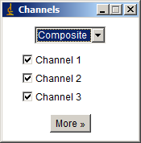
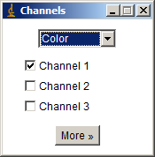
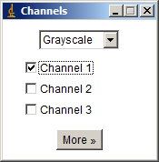
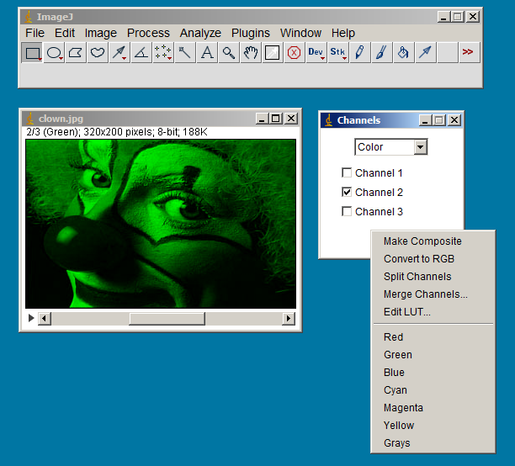
Channels tool
Multichannel overlay
Single channel view
Colour view
Grayscale view
Channel manipulations
Image / Adjust / Brightness contrast. If you press ‘Apply’ you change the image.
Image / Adjust / Colour Balance.
Best option – it allows changes to the display without changing the data. We will try this later…

Slide 23
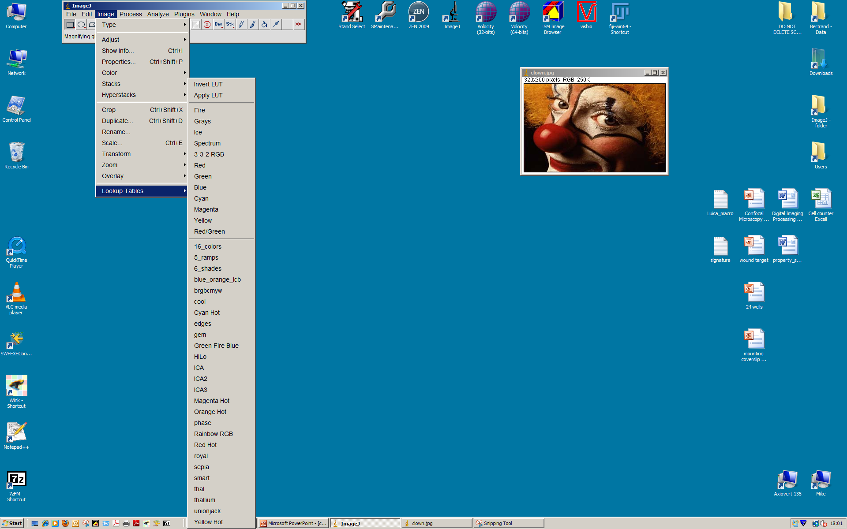
Changing channel’s color
Look up table : Assign a color or shade of a color to a pixel intensity
Grayscale
Red

Slide 24
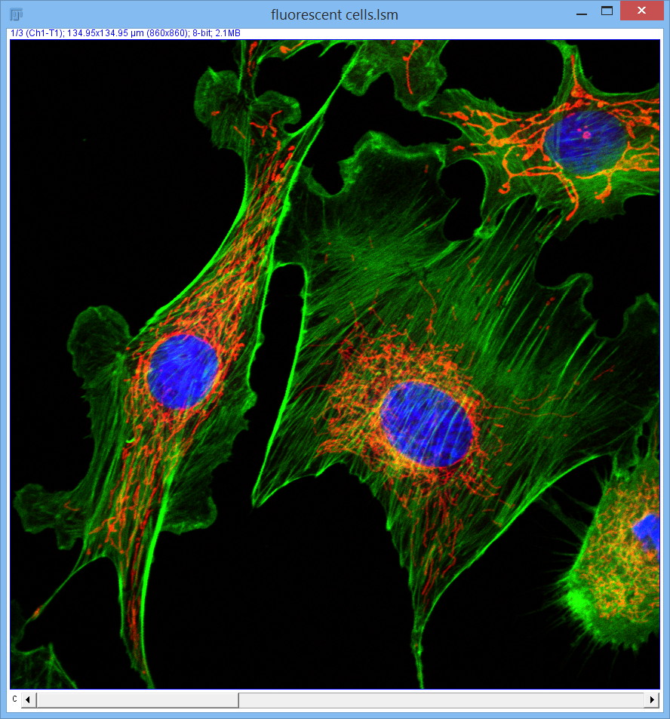
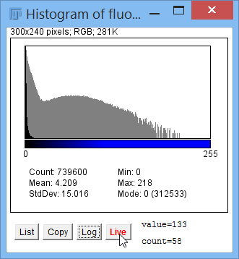
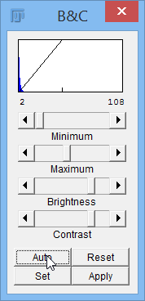

Brightness/Contrast (Shift + C) & Color Balance
Practice: Exercise Images / fluorescent cells.lsm
Make adjustments: Minimum, Maximum, etc. Auto. Apply – aaargh!
Use Image / Color / Color Balance try it…
(Press H)

Slide 25
Many images formats
GIF, TIF, BMP, PNG, ICS, JPEG, MPEG, Quicktime, SWF, PICT, EPS, PDF, PSD, XCF, …
Microscope specific formats
LIF, LEI, LSM, ZVI, CZI, STK, OIF, dv, r3d, PIC, IPL, OIB, OIF, ND2

Slide 26
Compression
Loss-less compression
Writes EXACTLY the same data in a smaller file
ZIP
Squishes by around 50%, no loss of data
Lossy compression
Change the dataset during compression
JPEG
NEVER USE for scientific data acquisition or quantitative expression analysis
Good for web publication and pictures distribution

Slide 27
Jpeg – lossy compression
Open fluorescent cells.lsm
(In folder Exercise Images)
Go to Edit>Options>Input/output
Set JPEG quality to 100 (best quality)
Save image as JPEG
OPEN the new JPEG version
Compare
To compare:
Image/ Colour/ Make Composite – give 3 channels –bar at bottom of image
Image/ Colour/ Channels tool (I always have this window open)
Switch to ‘Grayscale’ Select just one channel (3)
Note that to change channels you use the bar at the bottom of the image.
Analyze > Tools > Synchronise windows
Now switch between channels on the bottom bar in the image…

Slide 28
Which format to use ?
TIF
Loss-less compression
Suitable bit-depth
Space for meta-data (scaling, exposure, …)
Open source
Pretty much universal : should be readable in years from now
Most image acquisition software have proprietary formats exportable as TIFF

Slide 29
Metadata
Excitation wavelength
Emission wavelength
Dyes
Exposure
Gain
Offset
Time interval
Z-stack
Optical slice thickness
Objectives
Pixel size : scale bar
Personal notes
…
Use the proprietary file format or tiff format to save the essential metadata.

Slide 30
What’s a digital image?
Data
array of pixels (not squares or cubes, points)
each pixel has an intensity value
Metadata
How, What, Where, When, Who…

Slide 31


ImageJ distributions
ImageJ
http://imagej.nih.gov/ij/
Fiji
http://fiji.sc/wiki/index.php/Fiji

Slide 32
ImageJ features
Platform independent:
Linux, Mac OS and Windows in both 32-bit and 64-bit modes
Easiest to install with Java bundled
Open Source: FREE
User Community (mailing list):
ImageJ has a large and knowledgeable worldwide user community.
Macros:
Automate tasks and create custom tools using macros.
More than 300 macros are available on the ImageJ Web site.
Plugins (Java language):
Extend ImageJ by developing plugins using ImageJ's built in text editor and Java compiler. More than 500 plugins are available.

Slide 33
File Types
Data Types:
8-, 10-, 12-, 16- and 32-bit single channel images
3 channel 24-bits RGB images
8-, 12-, 16- and 32-bits multi-channel images
File Formats:
Open custom files from many acquisition software packages
Save all supported data types as TIFF
More image formats recognised with the bio-formats plugin http://www.openmicroscopy.org/site/support/bio-formats5.1/supported-formats.html
All your microscopy/medical images

Slide 34
ImageJ functions
Display (merge, split channels …)
Edit (R.O.I, scale bar, …)
Analyse (measurements, cell counting,..)
Process (z-projection, …)
Image maths (combine images – very useful for analysis)
Save
Print
And many more advanced functions …
You don’t need Photoshop !
Exercise 5) Make image montages for figures

Slide 35

Installing Fiji
http://fiji.sc/Downloads#Fiji
Don’t put it in the programs folder, just put it in the C or D drive.

Slide 36


Increase the memory allocation
Edit / options:
For ImageJ only.
Fiji automatically adjust the RAM usage
Adjust the RAM usage
Maximum Memory <75% real RAM

Slide 37
Links
ImageJ core program (latest version)
http://rsbweb.nih.gov/ij/download.html
Fiji program
http://fiji.sc/wiki/index.php/Fiji
User guides
online manual http://rsb.info.nih.gov/ij/docs/guide/index.html
pdf manual http://rsbweb.nih.gov/ij/docs/user-guide.pdf
Tutorials
ImageJ Wiki http://imagejdocu.tudor.lu/
EMBL course notes and PDF text book
http://cmci.embl.de/documents/ijcourses
New EMBL / Olympus textbook http://cmci.embl.de/
Macros
List of all macros http://rsbweb.nih.gov/ij/macros/
Macro commands http://rsb.info.nih.gov/ij/developer/macro/functions.html
Plugins
http://rsbweb.nih.gov/ij/plugins/index.html
http://fiji.sc/wiki/index.php/Category:Plugins
Worth a
look now…
Some nice macros (scratch assay)
Excellent downloaded PDF textbook / tutorials
On my reading list
Lots of macros – like Fit Ellipse
Dictionary of
Macro
commands
Most are inlcuded in Fiji, but extra info here
Good info for all Fiji plugins

